Slide 1

QBUS3350: Project Planning and Management
Monitoring Projects
Taught by
Dr. Erick Li
Discipline of Business Analytics

Slide 2
Structure of a Project Monitoring Information System
Creating a project monitoring system involves determining:
What data to collect
How, when, and who will collect the data
How to analyze the data
How to report current progress to management

Slide 3
Project Monitoring Information System
Information System Structure
What data are collected?
Current status of project (schedule and cost)
Remaining cost to compete project
Date that project will be complete
Potential problems to be addressed now
Out-of-control activities requiring intervention
Cost and/or schedule overruns and the reasons for them
Forecast of overruns at time of project completion

Slide 4
Project Monitoring System… (cont’d)
Information System Structure (cont’d)
Collecting data and analysis
Who will collect project data?
How will data be collected?
When will the data be collected?
Who will compile and analyze the data?
Reports and reporting
Who will receive the reports?
How will the reports be transmitted?
When will the reports be distributed?

Slide 5
Project Progress Report Format
Progress since last report
Current status of project
Schedule
Cost
Scope
Cumulative trends
Problems and issues since last report
Actions and resolution of earlier problems
New variances and problems identified
Corrective action planned

Slide 6
The Project Control Process
Control
The process of comparing actual performance against plan to identify deviations, evaluate courses of action, and take appropriate corrective action.
Project Control Steps
Setting a baseline plan.
Measuring progress and performance.
Comparing plan against actual.
Taking action.
Tools
Tracking and baseline Gantt charts
Control charts

Slide 7
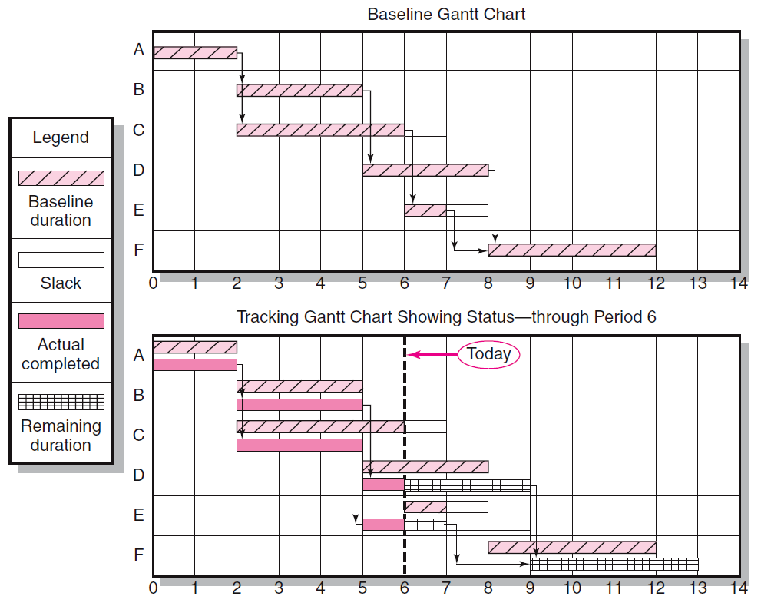
Baseline and Tracking Gantt Charts
Notes:
From the above Gantt chart, we can say that the critical path is A-B-D-F. The dependencies include: A has no predecessor, B and C follow A, D follows B, and F is preceded by D and E.
As at the end of day 6, we observe that A was completed on time. B was also completed on time. C was completed 1 day ahead of the schedule (but C is non-critical). However, we predicted that D would be delayed by 1 day. Because D is critical, the project completion time is expected to be 13 days in total.

Slide 8
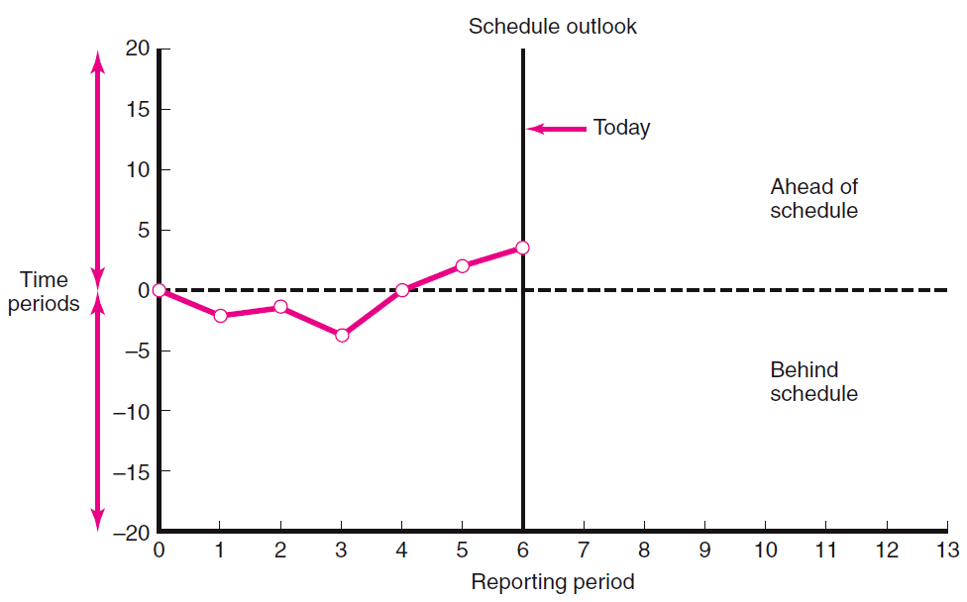
Project Schedule Control Chart
FIGURE 13.2

Slide 9
Disparity Among Monitoring Systems
Time-Phase Baseline Plan
Corrects the failure of most monitoring systems to connect a project’s actual performance to its schedule and forecast budget.
Systems that measure only cost variances do not identify resource and project cost problems associated with falling behind or progressing ahead of schedule.
Earned Value Cost/Schedule System
An integrated project management system based on the earned value concept that uses a time-phased budget baseline to compare actual and planned schedule and costs.

Slide 10
Glossary of Terms
EV | Earned value for a task is simply the percent complete times its original budget. Stated differently, EV is the percent of the original budget that has been earned by actual work completed. EV = original budget * percentage of project completion
PV | The planned time-phased baseline of the value of the work scheduled. An approved cost estimate of the resources scheduled in a time-phased cumulative baseline [BCWS—budgeted cost of the work scheduled].
AC | Actual cost of the work completed. The sum of the costs incurred in accomplishing work. [ACWP—actual cost of the work performed].
CV | Cost variance is the difference between the earned value and the actual costs for the work completed to date where CV = EV – AC.
SV | Schedule variance is the difference between the earned value and the baseline line to date where SV = EV – PV.
BAC | Budgeted cost at completion. Total budgeted cost of the baseline or project cost accounts.
EAC | Estimated cost at completion.
ETC | Estimated cost to complete remaining work.
VAC | Cost variance at completion. VAC indicates expected actual over- or under-run cost at completion.

Slide 11
Developing an Integrated Cost/Schedule System
Define the work using a WBS.
Scope
Work packages
Deliverables
Organization units
Resources
Budgets
Develop work and resource schedules.
Schedule resources to activities
Time-phase work packages into a network
Develop a time-phased budget using work packages included in an activity. Accumulate budgets (PV).
At the work package level, collect the actual costs for the work performed (AC). Multiply percent complete times original budget (EV).
Compute the schedule variance (EV-PV) and the cost variance (EV-AC).

Slide 12
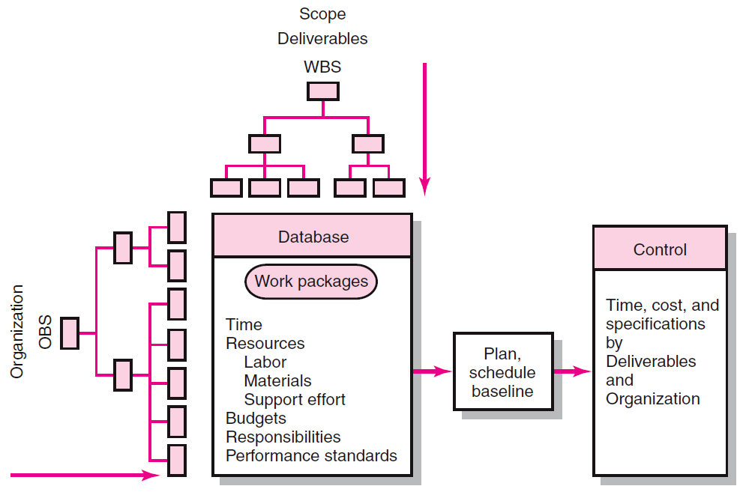
Project Management Information System Overview

Slide 13
Development of Project Baselines
Purposes of a Baseline (PV)
An anchor point for measuring performance
A planned cost and expected schedule against which actual cost and schedule are measured.
A basis for cash flows and awarding progress payments.
A summation of time-phased budgets (cost accounts as summed work packages) along a project timeline.
What Costs Are Included in Baselines?
Labor, equipment, materials, project direct overhead costs (DOC)

Slide 14
Development of Project Baselines (cont’d)
Rules for Placing Costs in Baselines
Costs are placed exactly as they are expected to be “earned” in order to track them to their point of origin.
Percent Complete Rule
Costs are periodically assigned to a baseline as units of work are completed over the duration of a work package.

Slide 15
Methods of Variance Analysis
Comparing Earned Value
With the expected schedule value.
With the actual costs.
Assessing Status of a Project
Required data elements
Data Budgeted cost of the work scheduled (PV)
Budgeted cost of the work completed (EV)
Actual cost of the work completed (AC)
Calculate schedule and cost variances
A positive variance indicates a desirable condition, while a negative variance suggests problems or changes that have taken place.

Slide 16
Methods of Variance Analysis
Cost Variance (CV)
Indicates if the work accomplished using labor and materials costs more or less than was planned at any point in the project.
Schedule Variance (SV)
Presents an overall assessment in dollar terms of the progress of all work packages in the project scheduled to date.

Slide 17
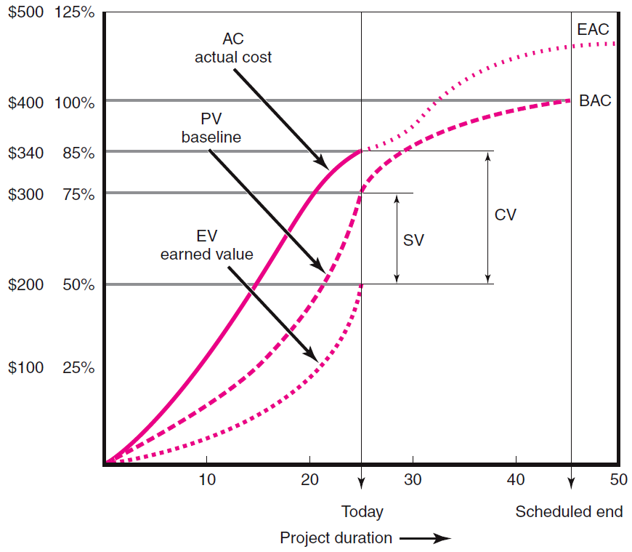
Cost/Schedule Graph
Notes:
The budgeted cost at completion is $400,000 and corresponds to 100%. There is one dashed line in the middle (sometimes it is not in the middle) represents the baseline. There is another curve showing the AC to date and this line extends to EAC (estimated cost at completion). The third curve is the earned value (EV) curve.

Slide 18
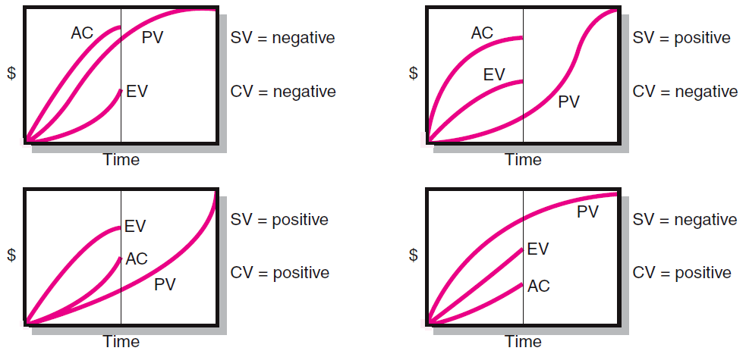
Earned-Value Review Exercise
Notes:
SV (schedule variance) = +ve : we are ahead of the project
CV (cost variance) = +ve : we are under the budget

Slide 19
Developing A Status Report: A Hypothetical Example
Assumptions
Each cost account has only one work package, and each cost account will be represented as an activity on the network.
The project network early start times will serve as the basis for assigning the baseline values.
From the moment work an activity begins, some actual costs will be incurred each period until the activity is completed.

Slide 20
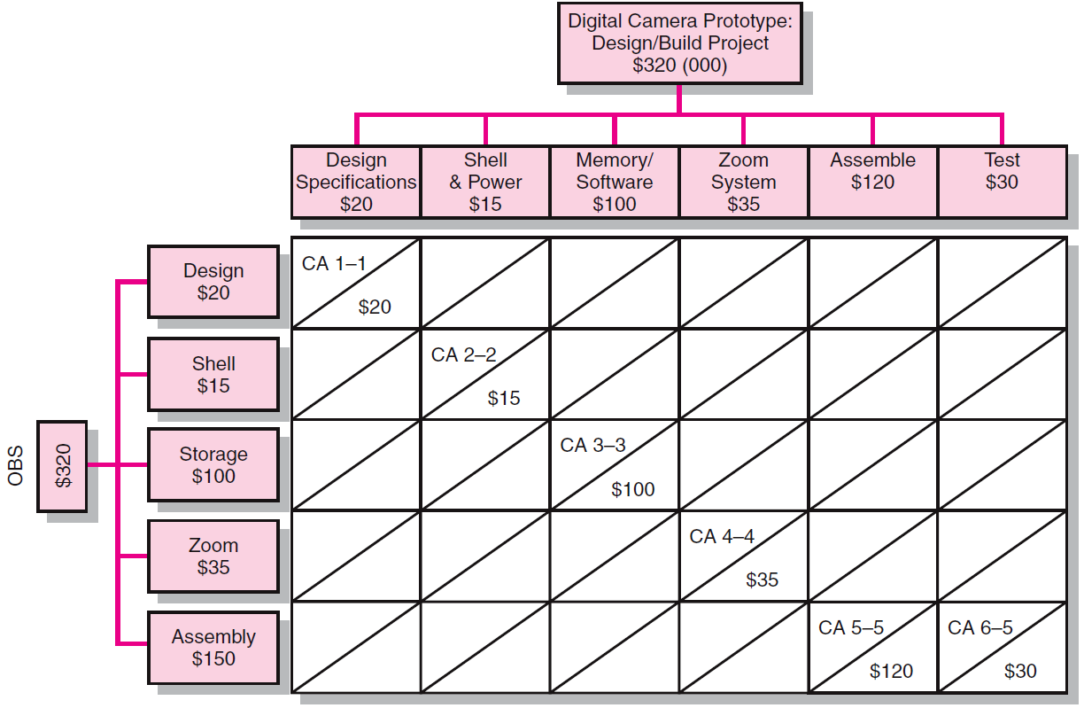
Work Breakdown Structure with Cost Accounts

Slide 21
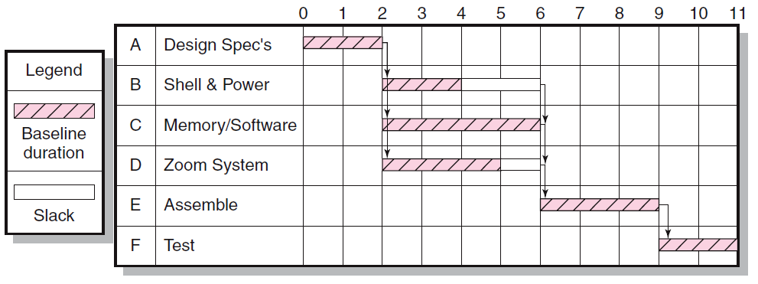
Digital Camera Prototype Project Baseline Gantt Chart
Notes:
The path A-C-E-F forms the critical path.

Slide 22
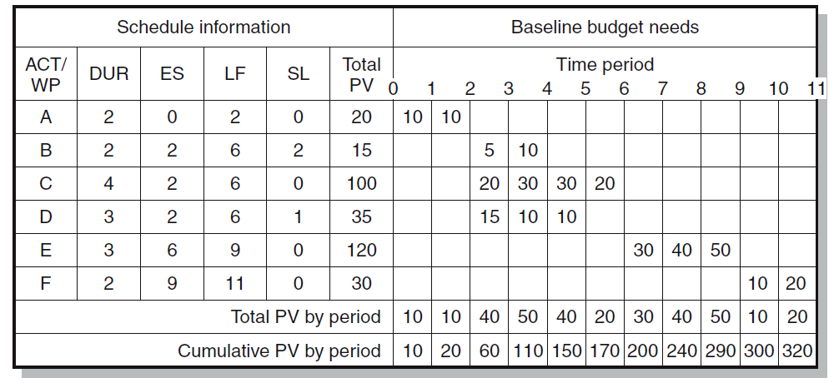
Digital Camera Prototype Project Baseline Budget ($000)
Notes:
We complete steps 1 and 2 already to create this time-phased baseline budget.

Slide 23
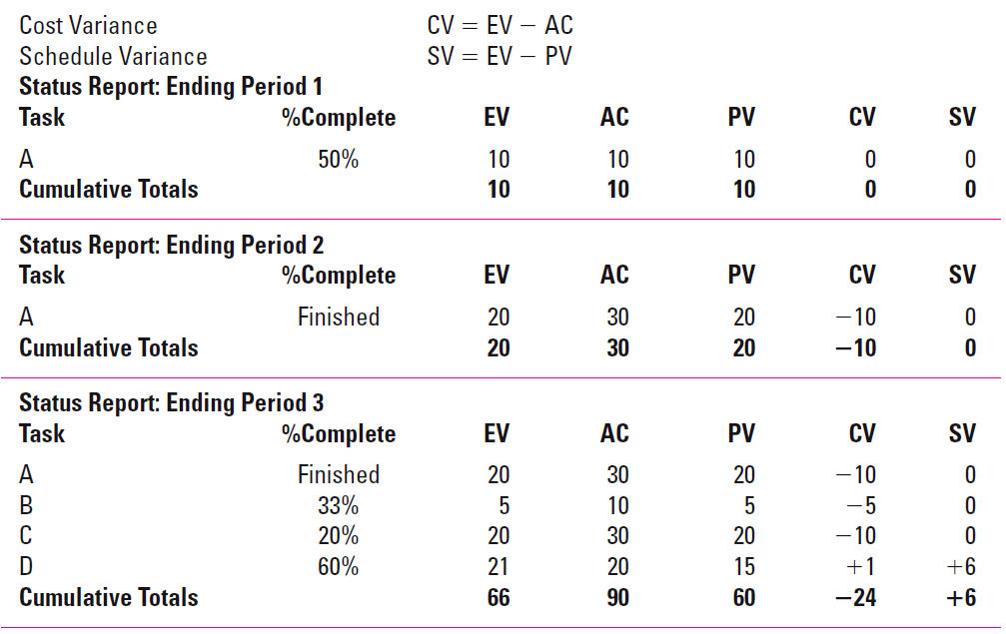
Digital Camera Prototype Status Reports: Periods 1–3
Notes:
AC and %complete must be given as input data.

Slide 24
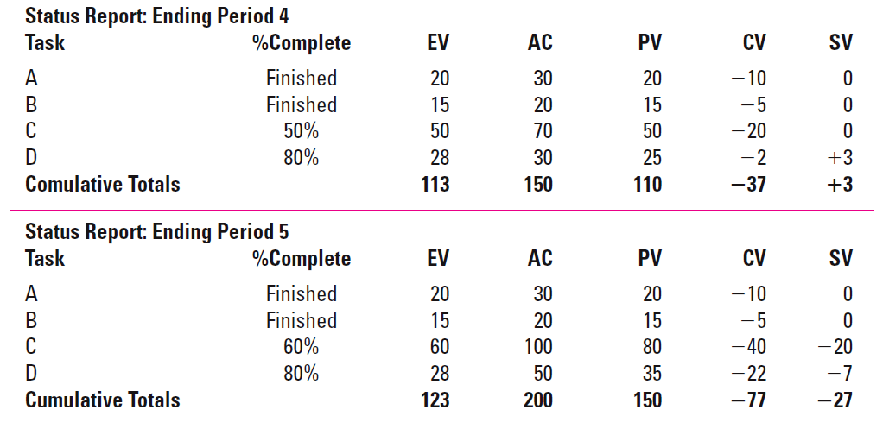
Digital Camera Prototype Status Reports: Periods 4 & 5

Slide 25
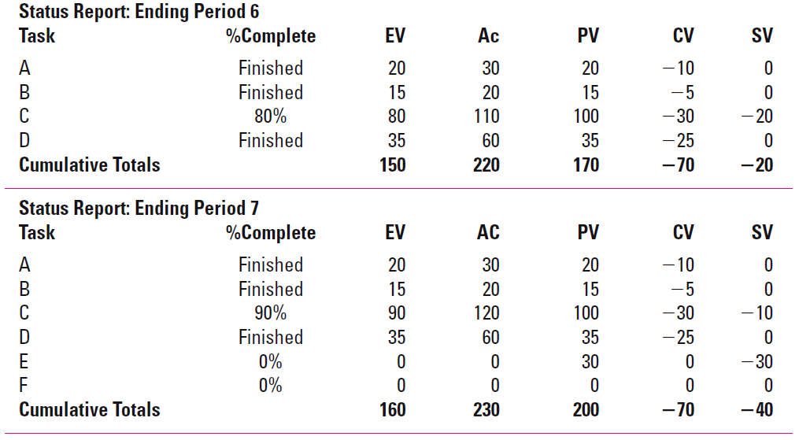
Digital Camera Prototype Status Reports: Periods 6 & 7

Slide 26
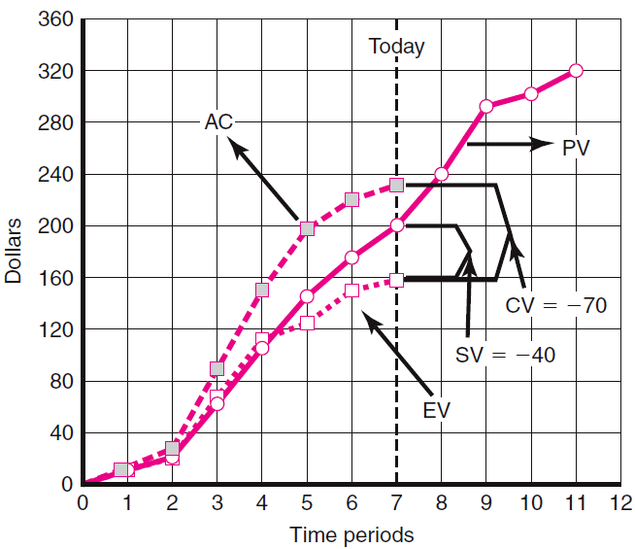
Digital Camera Prototype Summary Graph ($000)

Slide 27
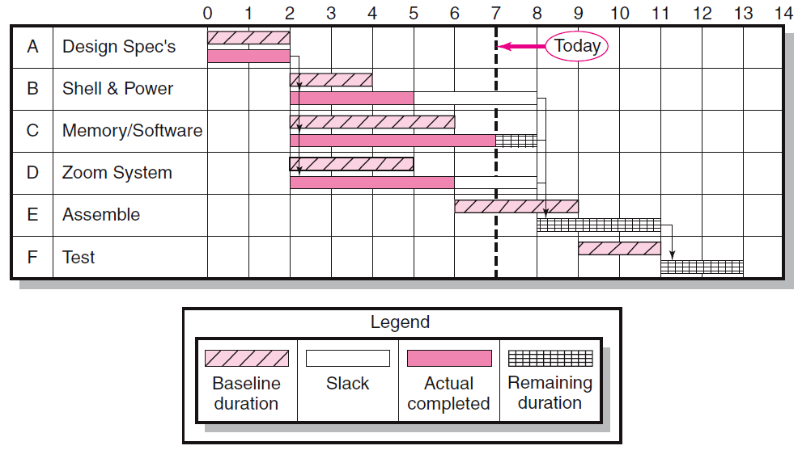
Digital Camera Project-Tracking Gantt Chart Showing Status—Through Period 7

Slide 28
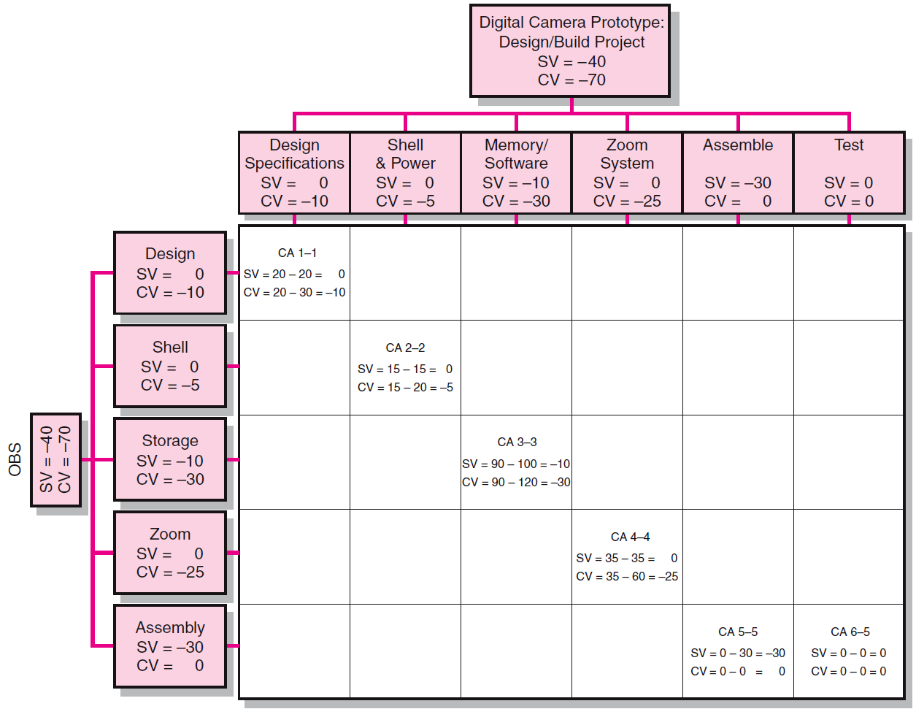
Project Rollup End Period 7 ($000)

Slide 29
Indexes to Monitor Progress
Performance Indexes
Cost Performance Index (CPI)
Measures the cost efficiency of work accomplished to date.
CPI = EV/AC
Scheduling Performance Index (SPI)
Measures scheduling efficiency
SPI = EV/PV
Percent Complete Indexes
Indicates how much of the work accomplished represents of the total budgeted (BAC) and actual (AC) dollars to date.
PCIB = EV/BAC
PCIC = AC/EAC

Slide 30
Interpretation of Indexes
Index | Cost (CPI) | Schedule (SPI)
>1.00 | Under cost | Ahead of schedule
=1.00 | On cost | On schedule
<1.00 | Over cost | Behind schedule

Slide 31
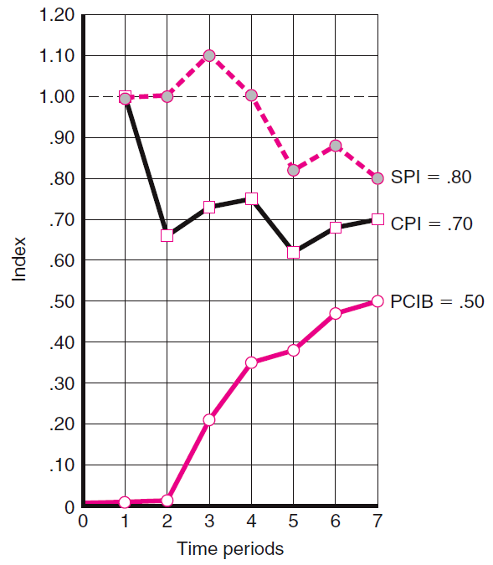
Indexes Periods 1–7

Slide 32
Additional Earned Value Rules
Rules applied to short-duration activities and/or small-cost activities
0/100 percent rule: based on amount of completed work
Assumes 100 % of budget credit is earned at once and only when the work is completed.
50/50 rule: has the problem of inflating the actual schedule
Allows for 50% of the value of the work package budget to be earned when it is started and 50% to be earned when the package is completed.
Percent complete with weighted monitoring gates
Uses subjective estimated percent complete in combination with hard, tangible monitoring points.

Slide 33
Forecasting Final Project Cost
Methods used to revise estimates of future project costs:
EAC_{re}
Allows experts in the field to change original baseline durations and costs because new information tells them the original estimates are not accurate.
EAC_{f}
Uses actual costs-to-date plus an efficiency index to project final costs in large projects where the original budget is unreliable.

Slide 34
Forecasting Model: EAC_{f}
The equation for this forecasting model:
ETC
Notes:
A typo in the picture that cannot be changed by me. It should be ETC = Work Remaining / CPI in the second line.

Slide 35
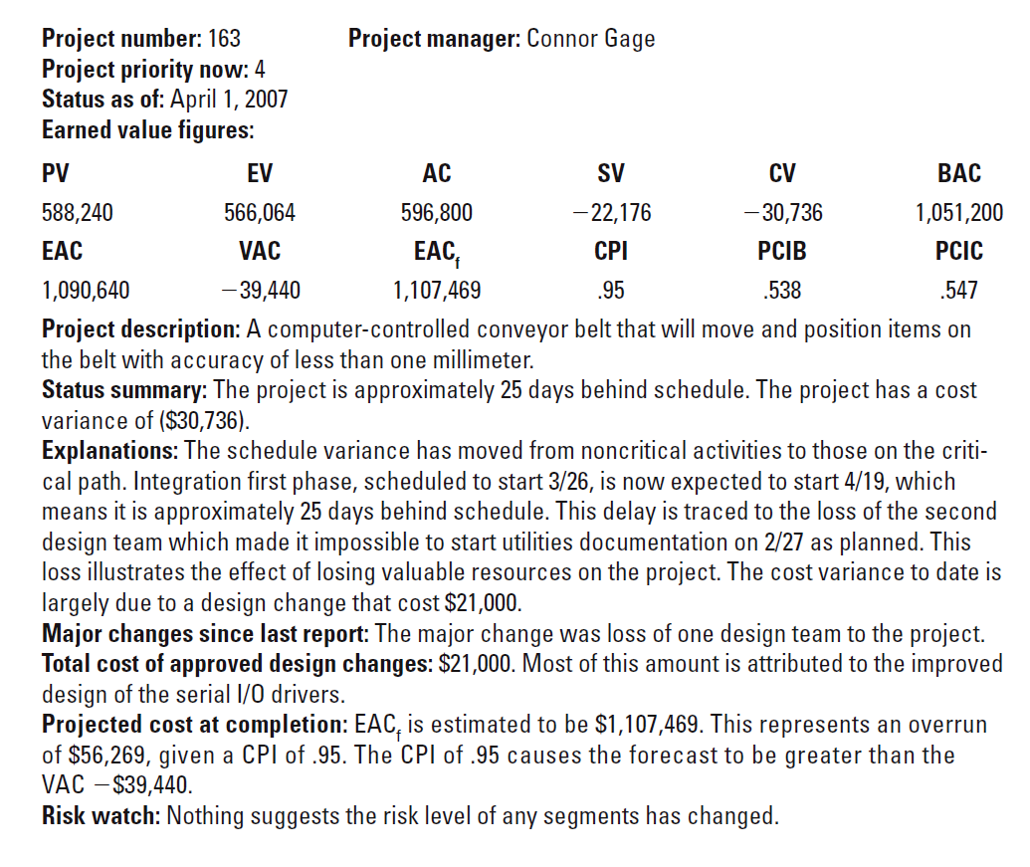
Monthly Status Report
Notes:
CV=566064-596800=-30736; SV=566064-588240=-22176;
CPI=566064/596800 = 0.95; SPI = 566064/588240=0.96;
EACf = (BAC-EV)/CPI + AC = (1051200-566064)/0.95 + 596800 = 1107469.
PCIB = EV / BAC = 566064/1051200 = 0.538;
PCIC = 596800/1090640 =0.547

Slide 36
Other Control Issues
Issues In Maintaining Control Of Projects
Scope Creep
Baseline Changes
Data Acquisition Costs and Problems

Slide 37
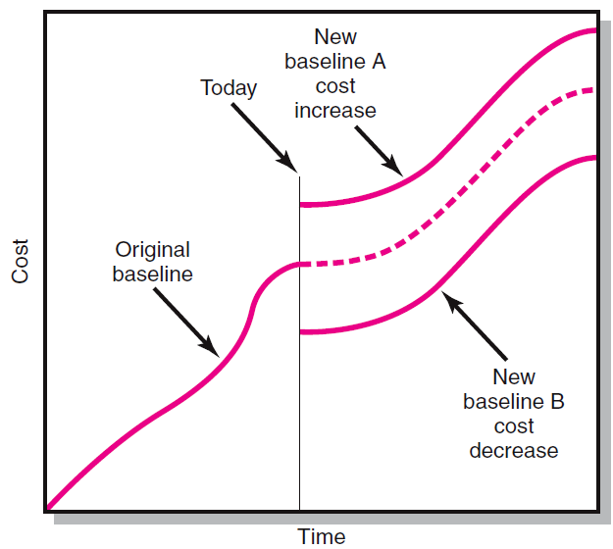
Scope Changes to a Baseline

Slide 38
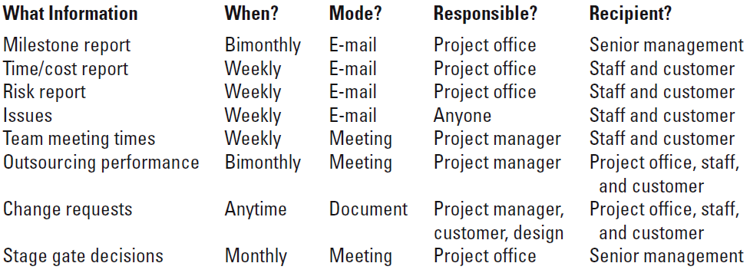
Conference Center WiFi Project Communication Plan

Slide 39
Make the Most of Meetings
Hold regular meetings
Meetings are typically the least favourite activity of busy, action-oriented people. However, they are often the best way to communicate information. Meetings provide forums within which project team members can share ideas and make decisions. To make the most of meetings, stick to a regular schedule as much as possible. If people know that project team meetings take place every Monday from 3 to 4 p.m., for example, they can plan their other responsibilities around those times. Having a regular schedule also saves meeting organizers the frustrating task of finding a time when everyone is available.
Notes:
Tips about managing project meetings.

Slide 40
Make the Most of Meetings
Write meeting minutes
If you're managing a sizable project with plenty of meetings and many participants, you can easily lose track of what has been done and what hasn't, who has agreed to things and who hasn't. To avoid this scenario, systematically keep track of decisions, assignments, and action items. Many organizations use meeting minutes—notes recorded by an appointed individual—for this purpose. The minutes are reviewed and approved at the next meeting and amended if necessary. Approved minutes then go into a file, where participants can consult them as needed.

Slide 41
What Went Wrong?
Any number of factors can cause your project's actual budget to deviate from projections.
You work for a major advertising firm. Between the months of January and June, your firm developed and launched a new campaign for Grumpleman's All-Natural Botanical Soap. Looking back, you see that your team was significantly over budget at various points during the project. Now you are trying to identify the contributing factors.

Slide 42
What Went Wrong?
One member of your team, Ben, attempts to explain the budget variance in February and March. "That was the creative development phase of the project. I think most of the variance in that period is due to overtime hours. The team went overboard on research and brainstorming work, because we thought our objective was to rethink Grumpleman's entire advertising strategy, not just to create new ads in line with their current strategy. We also thought that we'd be doing magazine and billboard ads in addition to TV spots. It didn't help that James left the firm in February; losing a team member meant that everyone else had to work more hours."

Slide 43
What Went Wrong?
Which of the following root causes of variance has Ben not identified?
A. Vague project objectives
B. Ambiguous project scope
C. Failure to manage risks (No contingency plan)
D. Unforeseen events
Ans: A, B and D
Notes:
Vague project objectives, ambiguous project scope, unforeseen events

Slide 44
What Went Wrong?
Allison, another member of the team, attempts to explain the major budget variance in May: "We had planned to wrap up shooting the new commercial spots in April. It turned out that filming continued into early May. Also, the client was adamant about buying ads during ABS's Wednesday prime time lineup, but ABS suddenly increased the price of those ads because of their successful new programs. We have to take some of the blame for this, though. Usually we budget extra amounts in case prices increase; I don't know why we didn't in this case."

Slide 45
What Went Wrong?
Which of the following root causes of variance has Allison not identified?
A. An incomplete project plan (didn’t have extra budget for price increase)
B. Failure to manage risks (risk: price increase)
C. External forces (ABS’s success on new program)
D. Overly optimistic schedule
Ans: B, C, and D
Notes:
Overly optimistic schedule, failure to manage risk, external forces.

Slide 46
Scope Creep
Scope creep is the tendency for the project scope to expand over time—usually by changing requirements, specifications, and priorities.
Scope creep should be avoided because it often contributes to project failure.
How to avoid scope creep? We write down the scope statement carefully (Topic 7: Scope Management).
Scope creep affects the organization, the project team and project suppliers.
Scope creep also relates to change management.

Slide 47
Key Terms
Baseline budget
Control chart
Cost performance index (CPI)
Cost variance (CV)
Earned value (EV)
Estimated Cost at Completion—Forecasted (EAC_{f})
Estimated Cost at Completion—Revised Estimates (EAC_{re})
Percent complete index—budget costs (PCIB)
Percent complete index—actual costs (PCIC)
Schedule performance index (SPI)
Schedule variance (SV)
Scope creep
To complete performance index (TCPI)
Tracking Gantt chart
Variance at completion (VAC)

Slide 48
Questions?

